Slide 1
Age-Group | Health-Risk
22 | 0
25 | 0
47 | 1
52 | 0
46 | 1
56 | 1
55 | 0
60 | 1
62 | 1
61 | 1
18 | 0
28 | 0
27 | 0
29 | 0
49 | 1
55 | 1
25 | 1
58 | 1
19 | 0
18 | 0
21 | 0
26 | 0
40 | 1
45 | 1
0= No Risk
Logistic Regression (Binary Classification)
1= Risk
Problem Statement:
Determine if the patient is at risk based on the patient's age group [Yes or No = Binary = [1, 0]]

Slide 2
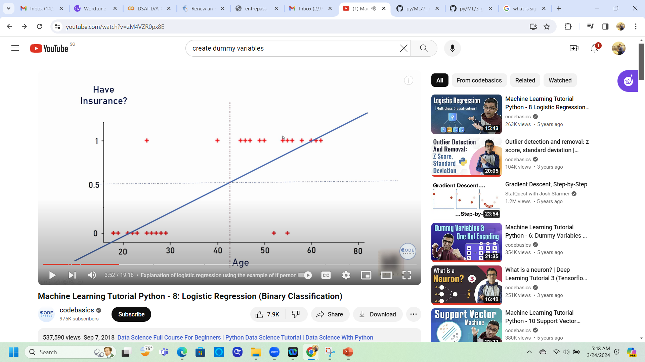
Patient Age vs Health Rik
Risk
Health Risk
No Risk
Age

Slide 3
Patient Age vs Health Rik
Risk
Health Risk
No Risk
Age

Slide 4
Patient Age vs Health Rik
An unconcerned patient
Patients who is risk-averse
Health Risk
Age

Slide 5
Patient Age vs Health Rik
Outliers
Health Risk
Outliers
Age

Slide 6
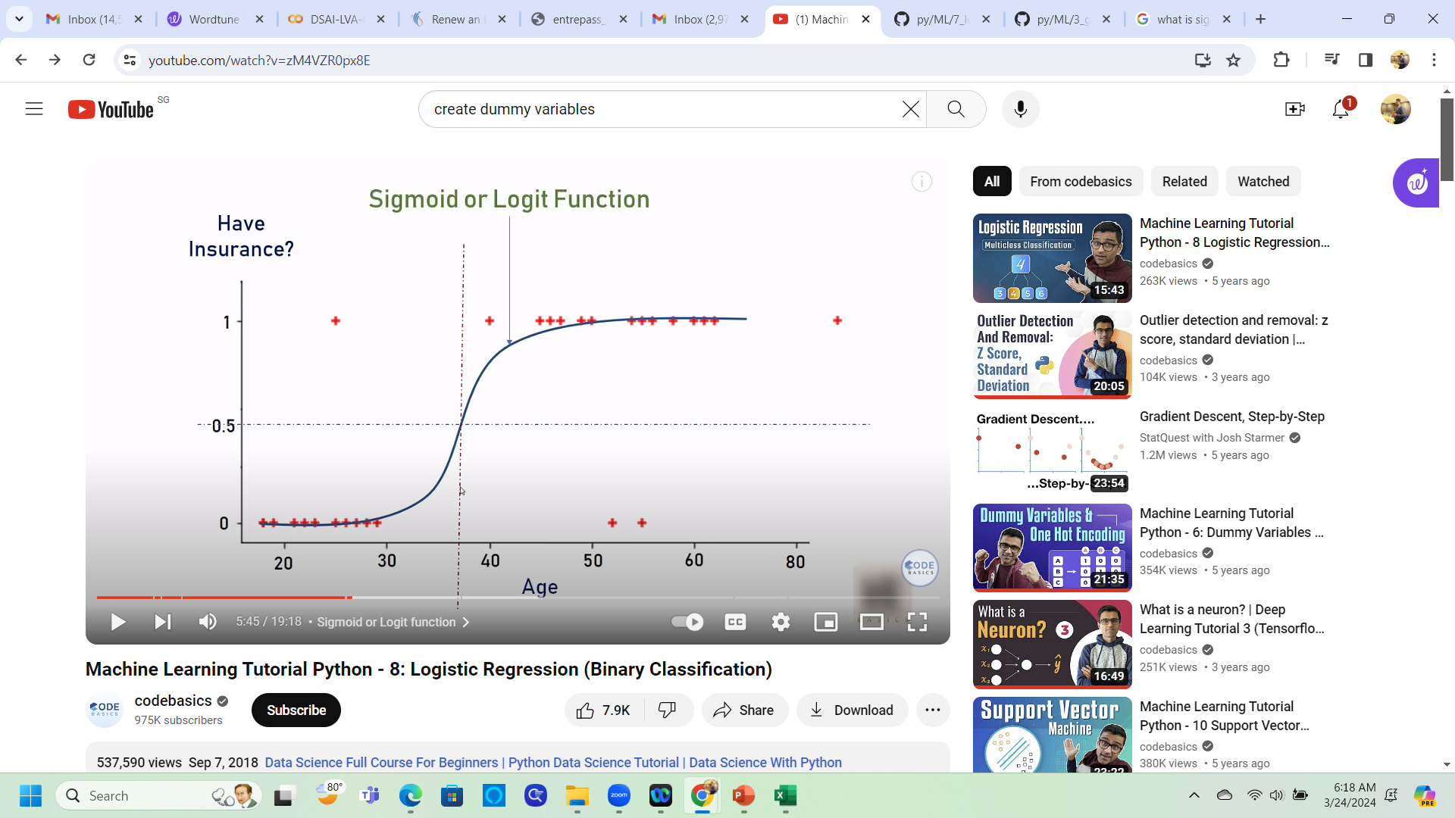
Patient Age vs Health Rik
Sigmoid Function
As compared to linear equations, the Sigmoid Function predicts that the same patients are risk-averse.

Slide 7
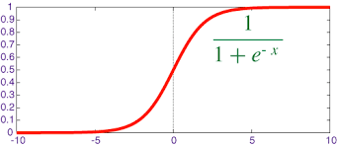
Patient Age vs Health Rik
Sigmoid Function
Where "e"= Euler's number ~ 2.71828 ( Some mathematical number)

Slide 8
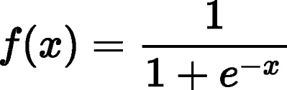
Patient Age vs Health Rik
Sigmoid Function
Sigmoid Function Converts the Inputs into Range Between 0 and 1

Slide 9
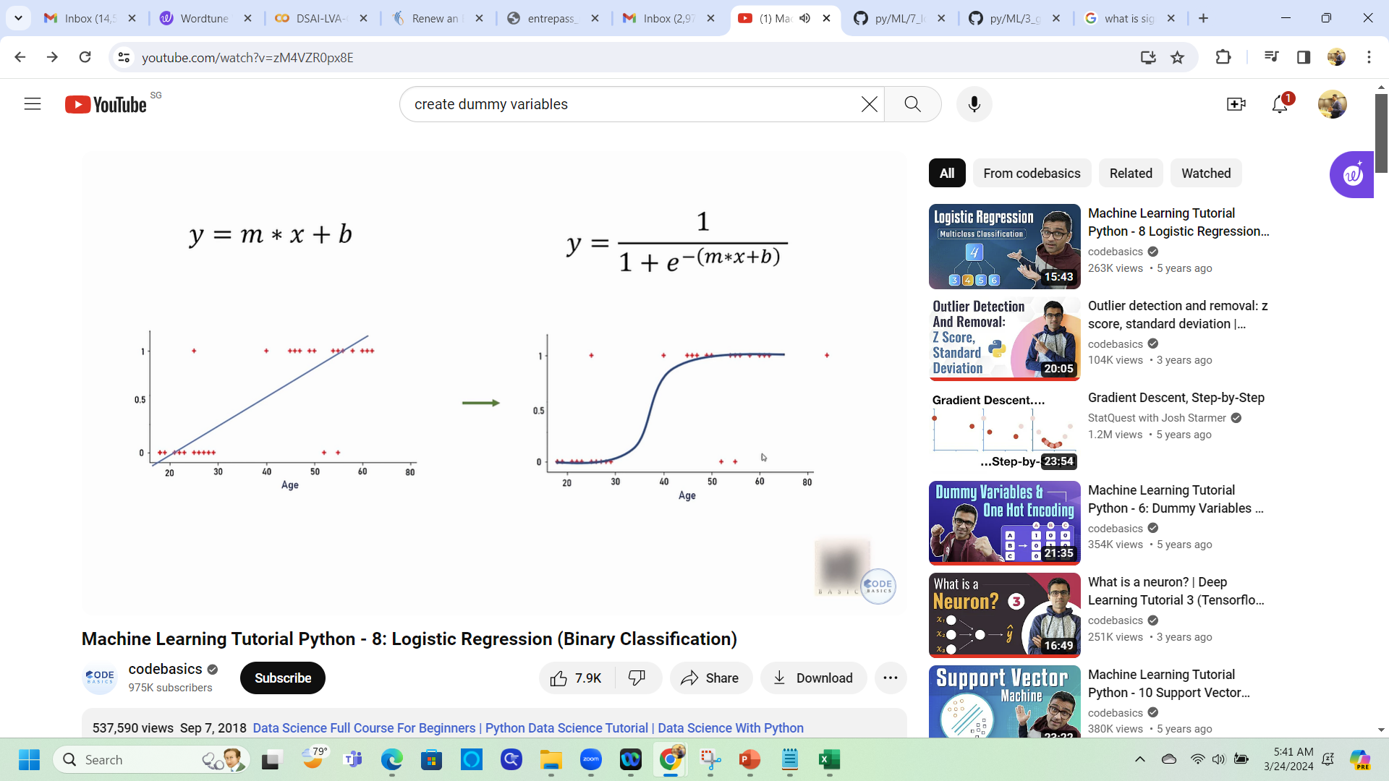
Patient Age vs Health Rik
The Sigmoid function is used to add non-linearity to a model
Sigmoid function

